Slide 1
Line detection using Hough Transform
By:
Laylo Zaridinova (203311003)
Ashutosh Mitra (203310012)

Slide 2
Our problem statement
Implement Hough transform for line detection using both equations for line
y=mx+c,
rho = xcos(theta) + ysin(theta)
(Avoid vertical lines in input data)

Slide 3
Hough Transform Applications
Extract important features of image like curves, corners and lines.
Recognizes objects, boundaries and segmentation.
Used in motion sensing games, path detection in self-drive cars, etc.
Plays a major role in computer vision and recognition

Slide 4
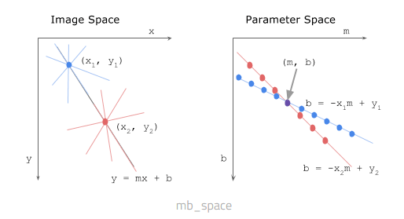

Slide 5
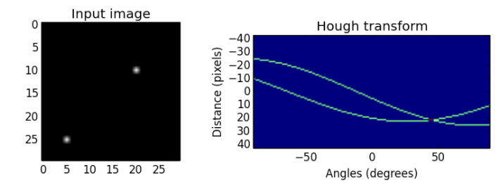

Slide 6
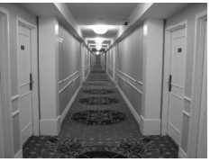
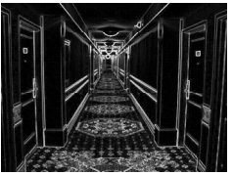
Example

Slide 7
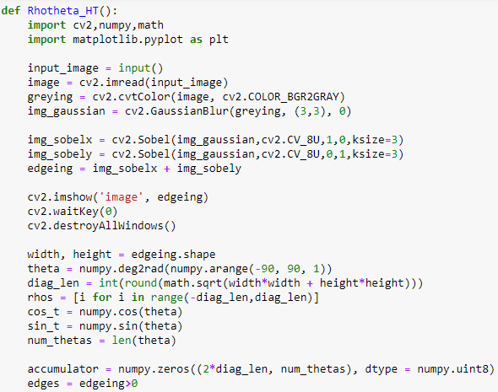
CODE (Rhotheta space)

Slide 8
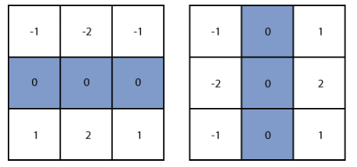
Sobel Operator

Slide 9
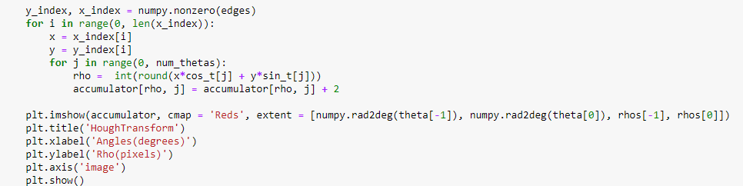
CODE (Rhotheta space)

Slide 10
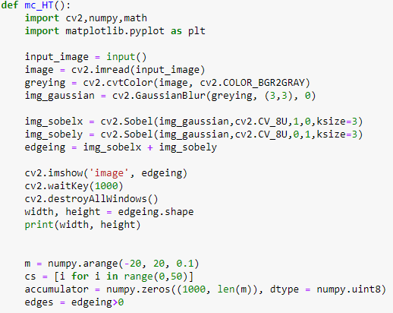
CODE (m-c space)

Slide 11
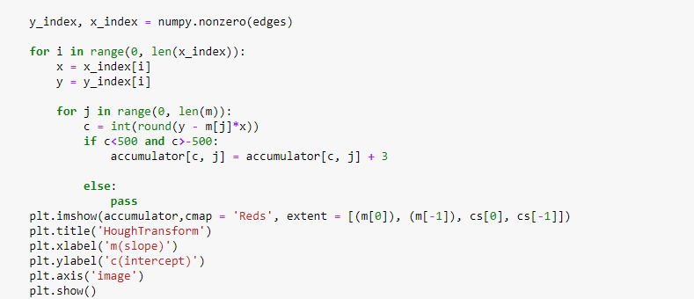
CODE (m-c space)

Slide 12
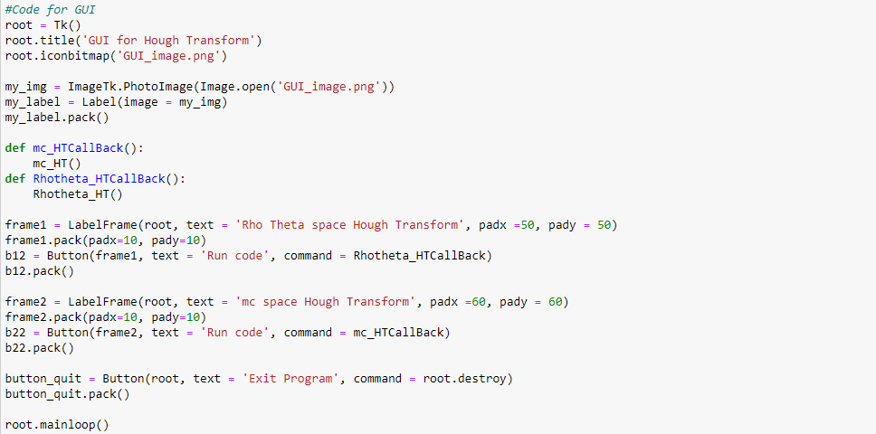
Graphical User Interface (GUI)

Slide 13
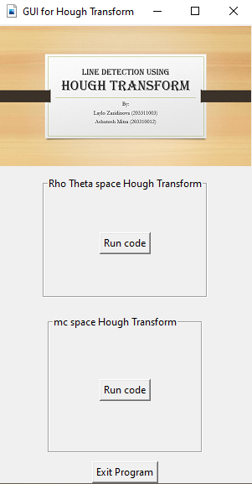

Slide 14

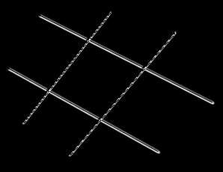
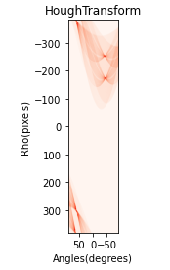
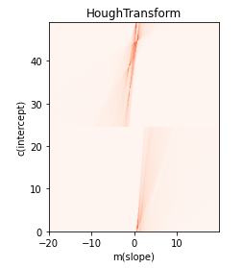

Slide 15
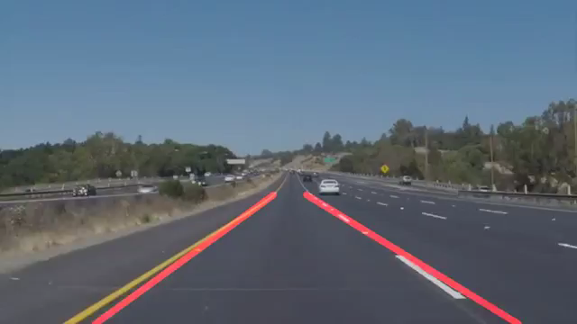
Application of line detection using Hough Transform in Self driving cars

Slide 16
THANK YOU FOR YOUR ATTENTION

